Slide 1
OmniMart Retailers
Customer & Business Insights Report
Team: ByteMe

Slide 2

Parameters Analysed
Product & Sales Parameters
Product Category Profitability (Treemap): Reveals the cash cows vs. the underdogs — where revenue is really coming from.
Sales Volume by Category: Confirms that it’s not just what customers buy, but how often — volume is the kingmaker.
Monthly Sales Trend: The business heartbeat — peaks, troughs, and sudden shocks that reveal seasonality and risks.
Customer Ratings Distribution: The voice of the customer — a quick read on whether we’re delighting, just satisfying, or disappointing.
Cross-Selling Affinity (Heatmap): Shows if customers treat us like a one-stop shop or just a single-purpose store — the untapped CLV goldmine.
Customer Parameters
RFM (Recency, Frequency, Monetary): The 3D lens to see customer value — who buys often, who spends big, and who might be drifting away.
CLV (Customer Lifetime Value): The total wallet a customer brings over time — proof that keeping a customer is 10x more valuable than chasing a new one.
Churn Risk: The early warning siren — tells us how many customers are about to walk out the door if we don’t act.
Top Customers by CLV: The “whales” — a handful of customers who make or break the revenue curve.
Market & Behavior Parameters
Revenue by Country: Where the money is really coming from — and whether we’re too dependent on one market.
Preferred Payment Methods: The checkout compass — showing how customers want to pay, and where friction might kill a sale.

Slide 3
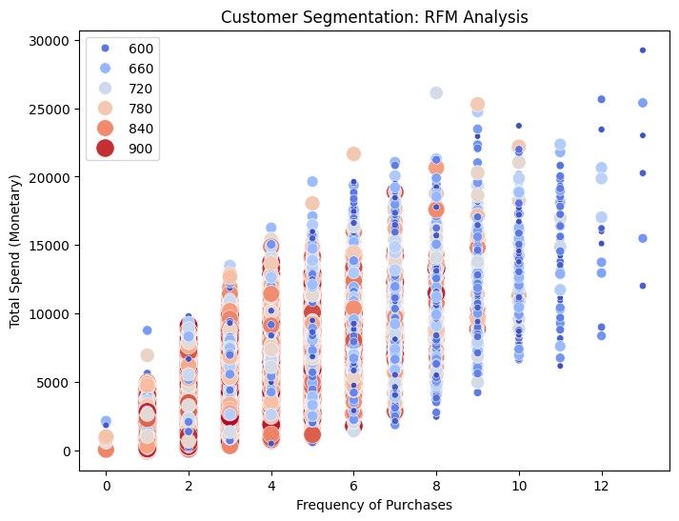
Customer Segmentation: RFM Analysis
Diagram Analysis
Scatter plot maps Frequency (X) vs Monetary Spend (Y), with Recency shown by color/size.
Clear positive correlation: higher frequency customers also spend more overall.
Large, red dots = recent, high-value customers; small, blue dots = inactive, low-value customers.
Business Insights
High-Value Champions: Frequent, high-spend, recent buyers = VIPs driving top revenue.
At-Risk Customers: Low frequency/recency, some previously high spenders → churn risk.
Growth Opportunities: Frequent low spenders (upsell) & infrequent high spenders (increase cadence).
Improvements to Be Done
Segment customers and run targeted campaigns for each group.
Reward Champions with exclusive VIP loyalty programs.
Re-engage At-Risk customers with personalized “we miss you” offers.

Slide 4
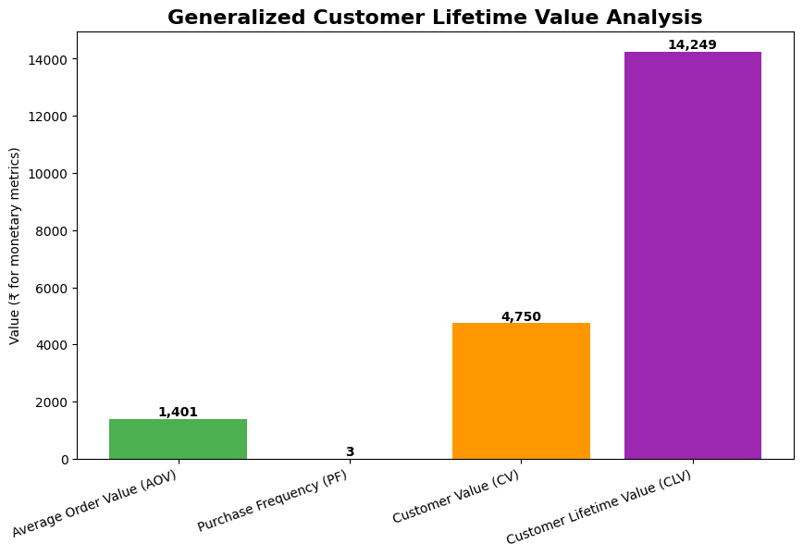
Generalized Customer Lifetime Value (CLV) Analysis
Diagram Analysis
Bar chart breaks down CLV components: AOV = ₹1,401, PF = 3, CV = ₹4,750, CLV = ₹14,249.
CLV is calculated as Customer Value × Average Customer Lifespan.
Visual highlights how small improvements in AOV or frequency multiply total CLV.
Business Insights
Retention is Key: CLV (~₹14.2k) is 10x a single purchase, showing repeat buyers drive profitability.
Growth Levers: Two main levers → raise AOV or increase purchase frequency.
Acquisition Benchmark: CAC must stay well below ₹14.2k to ensure profitable growth.
Improvements to Be Done
Double down on retention programs (loyalty tiers, personalized engagement).
Boost AOV with bundling, volume discounts, and smart recommendations.
Continuously track CAC vs CLV to optimize acquisition spend.

Slide 5
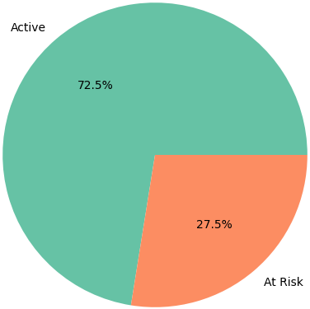
Customer Churn Risk
Diagram Analysis
Pie chart divides customers: Active (72.5%) vs At Risk (27.5%).
Nearly 1 in 4 customers is at risk of leaving.
Simple visualization but highlights a significant retention gap.
Business Insights
Revenue Threat: Losing 27.5% of the base could cut future revenue substantially.
Retention Priority: Retaining is cheaper and more profitable than acquiring new customers.
KPI Benchmark: 27.5% churn risk sets a measurable baseline for tracking retention strategy success.
Improvements to Be Done
Identify & Segment: Pinpoint at-risk customers using RFM data (low recency/frequency).
Re-engagement Campaigns: Deploy “we miss you” offers, personalized emails, and product nudges.
Collect Feedback: Use surveys to understand lapses and fix root causes (service, pricing, or product quality).

Slide 6
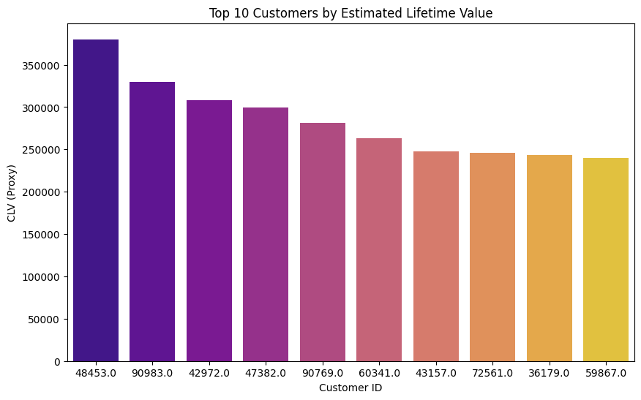
Top 10 Customers by Estimated Lifetime Value
Diagram Analysis
Bar chart displays the Top 10 customers by CLV, ranging from ~₹240K to ₹375K+.
Top customer’s CLV is 26× higher than the average customer.
Strong visual emphasis on the outsized contribution of a small segment.
Business Insights
VIP Concentration: A handful of customers generate disproportionate revenue.
Retention Sensitivity: Losing just one top customer would cause significant financial impact.
Strategic Leverage: These customers serve as both revenue anchors and models for targeting similar profiles.
Improvements to Be Done
VIP Program: Provide exclusive perks, priority service, and personal account management.
Risk Mitigation: Monitor satisfaction of top customers with proactive service touchpoints.
Lookalike Acquisition: Build digital ad segments based on VIP traits to attract similar high-value customers.

Slide 7
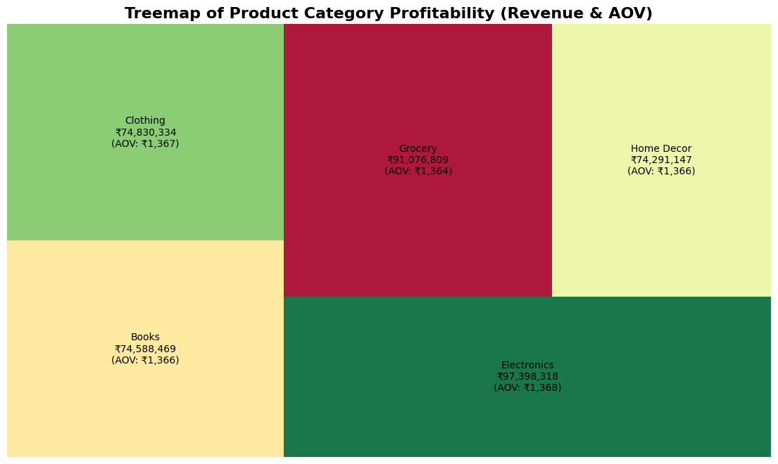
Treemap of Product Category Profitability
Diagram Analysis
Treemap shows revenue share by category, sized proportionally.
Electronics (₹97.4M) and Grocery (₹91.1M) dominate total revenue.
Average Order Value (AOV) is consistent across categories (~₹1,366).
Business Insights
Volume-Driven Revenue: Similar AOV means transaction volume is the real differentiator.
Predictable Basket Size: Spending behavior appears capped by a common threshold (e.g., shipping limits or psychological pricing).
Category Imbalance: Clothing, Books, and Home Decor underperform compared to leaders.
Improvements to Be Done
Boost Underperformers: Use targeted promotions, bundles, and cross-selling to lift weaker categories.
Experiment with AOV: Test raising free shipping thresholds to nudge larger baskets.
Leverage Leaders: Use Electronics & Grocery traffic to promote secondary categories via on-site and email campaigns.

Slide 8
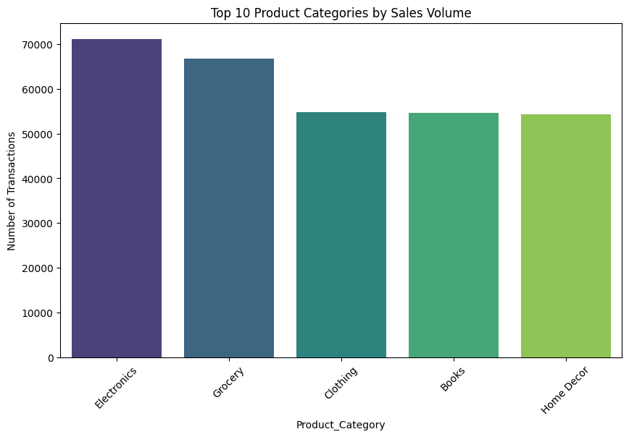
Top 10 Product Categories by Sales Volume
Diagram Analysis
Bar chart ranks categories by transaction count.
Electronics leads, followed by Grocery.
Clothing, Books, Home Decor cluster together with lower volumes.
Business Insights
Core Categories: Electronics and Grocery generate the majority of sales activity.
Revenue Alignment: Volume ranking matches revenue ranking, confirming sales volume as the main driver.
Growth Gap: Lower-volume categories show room for expansion if engagement increases.
Improvements to Be Done
Inventory Optimization: Maintain strong stock levels for Electronics and Grocery to avoid lost sales.
Cross-Selling: Leverage traffic from Electronics/Grocery to promote underperforming categories.
Targeted Campaigns: Run offers and recommendations to push Clothing, Books, and Home Decor.

Slide 9
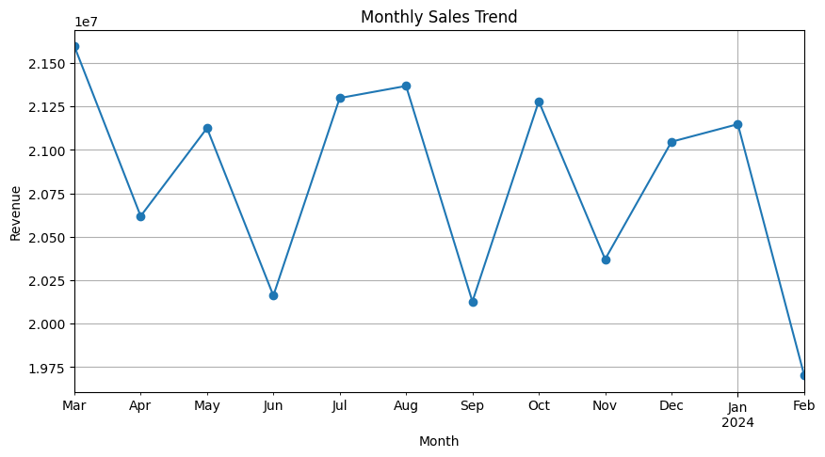
Monthly Sales Trend
Diagram Analysis
Line chart shows revenue from Mar 2023 – Feb 2024.
Clear seasonality: peaks in Aug & Oct, troughs in Jun & Nov.
Sharp drop in Feb 2024 after Jan, marking an anomaly.
Business Insights
Seasonal Dependence: Sales cycles align with festivals/promotions (e.g., Diwali).
Revenue Volatility: Consistent ups and downs indicate reliance on seasonal peaks.
Red Flag: Feb 2024 collapse suggests operational, competitive, or marketing issues.
Improvements to Be Done
Root Cause Analysis: Investigate Feb dip → check inventory, marketing, payment, and competitor activity.
Peak Planning: Scale inventory & campaigns before expected high-demand months.
Revenue Smoothing: Run special promotions in low-demand months to stabilize sales.

Slide 10
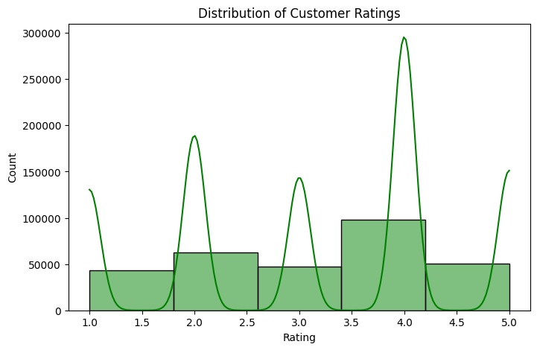
Distribution of Customer Ratings
Diagram Analysis
Histogram shows ratings skewed toward 4 stars (most common).
Noticeable share of 2–3 star ratings indicating dissatisfaction.
Very few 5-star ratings → lack of strong customer delight.
Business Insights
Satisfied, Not Delighted: Majority are content but not advocates (risk of churn if competition offers better).
Experience Gaps: High volume of 2–3 star reviews reveals unresolved pain points.
Feedback Value: Low ratings are direct signals for improvement opportunities.
Improvements to Be Done
Deep Dive Analysis: Text mining of low ratings to extract recurring complaints.
Operational Fixes: Tackle top issues (e.g., delivery delays, product defects, packaging).
Customer Recovery: Engage unhappy customers with service recovery offers and follow-ups.

Slide 11
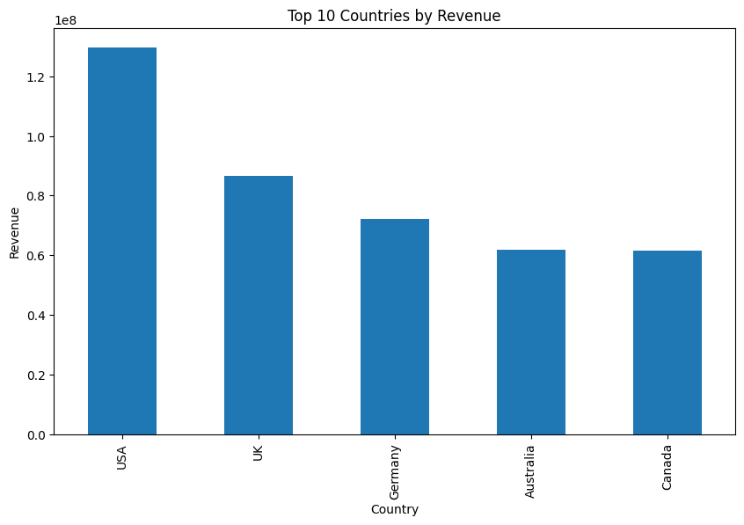
Top 10 Countries by Revenue
Diagram Analysis
Bar chart ranks USA as the dominant market, far ahead of others.
Secondary contributors: UK, Germany, Australia, Canada with moderate revenue.
Clear visualization of geographic imbalance in revenue share.
Business Insights
Strong Core Markets: Business is anchored in mature Western economies.
Concentration Risk: Over-reliance on the US makes revenue vulnerable to market shocks.
Growth Potential: Secondary markets are underleveraged but have room to expand.
Improvements to Be Done
Geographic Diversification: Enter additional promising regions to spread revenue risk.
Localized Strategies: Tailor campaigns by culture, holidays, and consumer behavior per country.
Market Penetration: Invest in deeper engagement within UK, Germany, Australia, and Canada.

Slide 12
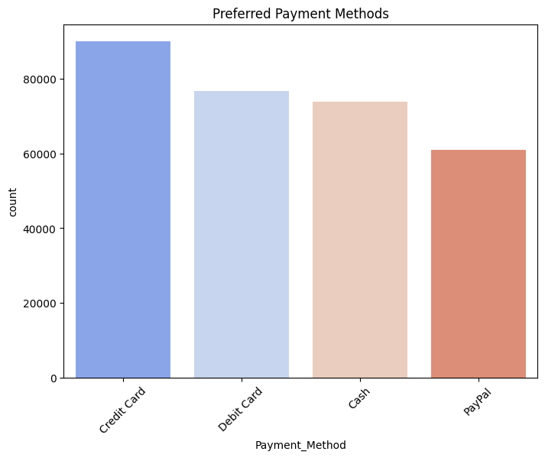
Preferred Payment Methods
Diagram Analysis
Chart shows Credit Card as the top payment choice, followed closely by Debit Card.
Cash usage remains high, indicating reliance on COD or in-person transactions.
PayPal adoption is minimal compared to other methods.
Business Insights
Digital Cards Dominate: Credit and Debit are the backbone of transactions.
COD Significance: Cash indicates customer trust issues with digital or presence in offline/last-mile contexts.
Conversion Driver: Broader, frictionless payment options can improve checkout completion.
Improvements to Be Done
Checkout Optimization: Simplify and secure the card payment experience, especially for mobile.
Add Wallets: Introduce Apple Pay, Google Pay, and local e-wallets to expand choice.
Promote Digital Use: Incentivize customers to shift from COD to digital for efficiency and reduced risk.

Slide 13
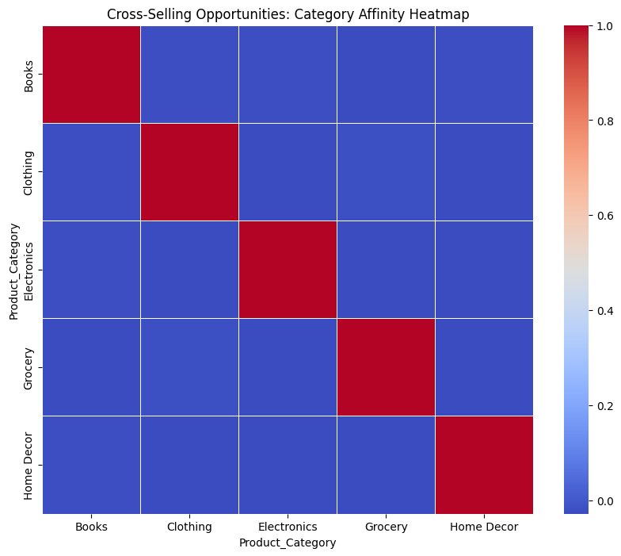
Cross-Selling Opportunities: Category Affinity Heatmap
Diagram Analysis
Heatmap diagonal (red = 1.0) shows each category aligns only with itself.
All off-diagonal cells are dark blue, indicating near-zero cross-category correlation.
Customers purchase from one category only, not exploring others.
Business Insights
No Cross-Sell Behavior: Customers don’t mix categories (Electronics ≠ Books, Grocery ≠ Clothing).
Siloed Shopping: Store is seen as multiple niche shops instead of a unified marketplace.
Untapped Revenue: Cross-selling could significantly lift CLV with minimal acquisition cost.
Improvements to Be Done
Recommendation Engine: Deploy “Customers Also Bought” & “Frequently Bought Together” across categories.
Cross-Category Bundles: Design multi-category offers (e.g., Movie Night Pack: Electronics + Grocery + Home Decor).
Targeted Email Marketing: Promote unexplored categories to customers based on their primary purchase behavior.

Slide 14
Summaries
Stage 1: Diagnosis
Customer base split into Champions, At-Risk, and Growth segments.
Average CLV = ₹14.2K, proving retention > acquisition.
Electronics & Grocery dominate revenue; weak categories underperform.
Sales show strong seasonality, with Feb 2024 crash a major anomaly.
Ratings skew to 4 stars, but too many 2–3 star reviews highlight service/product gaps.
Heavy reliance on US market and male shoppers; limited cross-category buying.
Stage 2: Risks
27.5% customers are “At Risk” of churn.
Loss of top 10 VIP customers would cause outsized revenue damage.
Geographic concentration in USA exposes revenue to macro shocks.
Sales volatility tied to seasonality, plus unexplained Feb decline.
Customer dissatisfaction signals risk of negative word of mouth.
Stage 3: Opportunities
Boost retention with loyalty, win-back, and upsell programs.
Expand weaker categories via bundles and cross-category promotions.
Activate cross-selling to unlock new CLV growth.
Target female shoppers for incremental revenue.
Diversify markets beyond the US into UK, Germany, Australia, and Canada.
Stage 4: Actions
Immediate: Investigate Feb dip, run re-engagement for at-risk customers, fix checkout/payment friction.
Short-Term: Launch VIP program, optimize inventory, pilot cross-category bundles.
Mid-Term: Deploy recommendation engines, raise shipping thresholds, localize marketing.
Long-Term: Build predictive churn models, expand loyalty programs, pursue new geographies.

Slide 15
Key Takeaways
Key Takeaways
Retention is the growth engine — CLV is 10× a single order, so reducing churn (27.5%) must be top priority.
Revenue is volume-driven — Electronics & Grocery lead; weaker categories need cross-sell and promotion.
Customer experience gaps are holding growth back — delivery, product quality, and service must be fixed.
Revenue is concentrated — too dependent on US market, male shoppers, and siloed purchase behavior.
Opportunities are clear — cross-selling, geographic expansion, female segment targeting, and loyalty programs can deliver sustainable growth.

